Slide 1


Slide 2
introduction
Sorting refers to arranging a set of data in some logical order.
For eg. A telephone directory can be considered as a list where each record has three fields – name,address,phone number.
Being unique, phone number can work as a key to locate any record in the list.
Sorting techniques allows an efficient arrangement of elements within a given data structure. It is a way in which the elements are organized systematically for some purpose.

Slide 3
Introduction
Sorting is among the most basic problems in algorithmic design.
We are given a sequence of items , each associated with a given key value. And the problem is to rearrange the items so that they are in an increasing (or decreasing) order by key.
The methods of sorting can be divided into 2 categories:
Internal Sorting
External Sorting

Slide 4
Internal Sorting
If the input data is such that it can be adjusted in the main memory at once, it is called internal sorting.
Eg: Bubble sort , Insertion Sort, Selection Sort, Quick Sort ,Heap Sort ,Bucket Sort …
External Sorting
If the input data is such that it cannot be adjusted in the memory entirely at once, it needs to be stored in a hard disk, floppy disk, or any other storage device. This is called external sorting.
Eg: Merge sort, tape sort….
NOTE : We will only consider Internal sorting.

Slide 5
Efficiency of sorting algorithm
The complexity of a sorting measures the running time of a function in which n number of items are to be sorted.
Various sorting methods are analyzed in the cases like – best case , worst case or average case.
Most of the sort methods we consider have requirements that range from O(nlogn) to O(n^2).
A sort should not be selected only because its sorting time is O(nlogn) the relation of the file size n and the other factors affecting the actual sorting time must be considered.

Slide 6
Bubble sort/sinking sort (sorting by exchange):
In bubble sort, each element is compared with its adjacent element.
We begin with the 0th element and compare it with the 1st element.
If it is found to be greater than the 1st element, then they are interchanged.
In this way all the elements are compared(excluding last)with their next element and are interchanged if required.
On completing the first iteration , largest element gets placed at the last position. Similarity in second iteration second largest element gets placed at the second last position and so on.

Slide 7
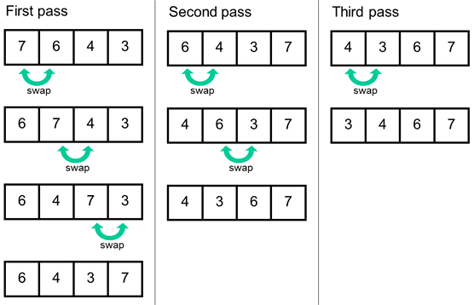

Slide 8
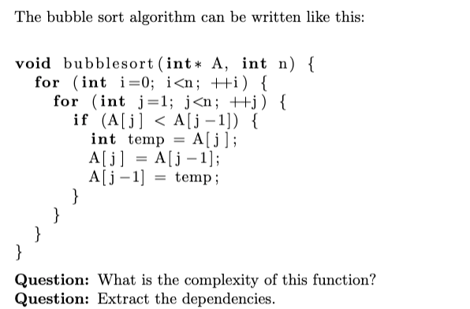
algorithm

Slide 9
Time complexity
The time complexity for bubble sort is calculated in terms of the number of comparisons f(n) (or of number of loops)
Here two loops (outer loop and inner loop) iterates the comparison.
The inner loop is iterated one less than the number of elements in the list(i.e., n-1 times) and is reiterated upon every iteration of the outer loop
f(n) = (n-1)+(n-2)+……………………+2+1
=n(n-1) ~ O(n²)

Slide 10
Time Complexities
Worst Case Complexity: O(n²) If we want to sort in ascending order and the array is in descending order then the worst case occurs.
Best Case Complexity: O(n) If the array is already sorted, then there is no need for sorting.
Average Case Complexity: O(n²) It occurs when the elements of the array are in jumbled order (neither ascending nor descending).
Space Complexity :
Space complexity is O(1) because an extra variable is used for swapping.

Slide 11
Selection sort
The name itself indicates the sorting process done based on selection .
Find the least(or greatest) value in the array, swap it into the leftmost(or rightmost) component, and then forget the leftmost component, Do this repeatedly.
Let a[n] be a linear array of n elements. The selection sort works as follows:
Pass 1: Find the location loc of the smallest element in the list of n elements a[0], a[1], a[2], a[3],........., a[n-1] and then interchange a[loc] and a[0].
Pass 2: Find the location loc of the smallest element int the sub-list of n-1 elements a[1], a[2], a[3],.........,a[n-1] and then interchange a[loc] and a[1] such that a[0], a[1] are sorted.
Then we will get the sorted list a[0]<=a[2]<=a[3]......<=a[n-1]

Slide 12
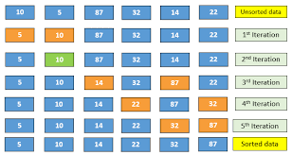

Slide 13
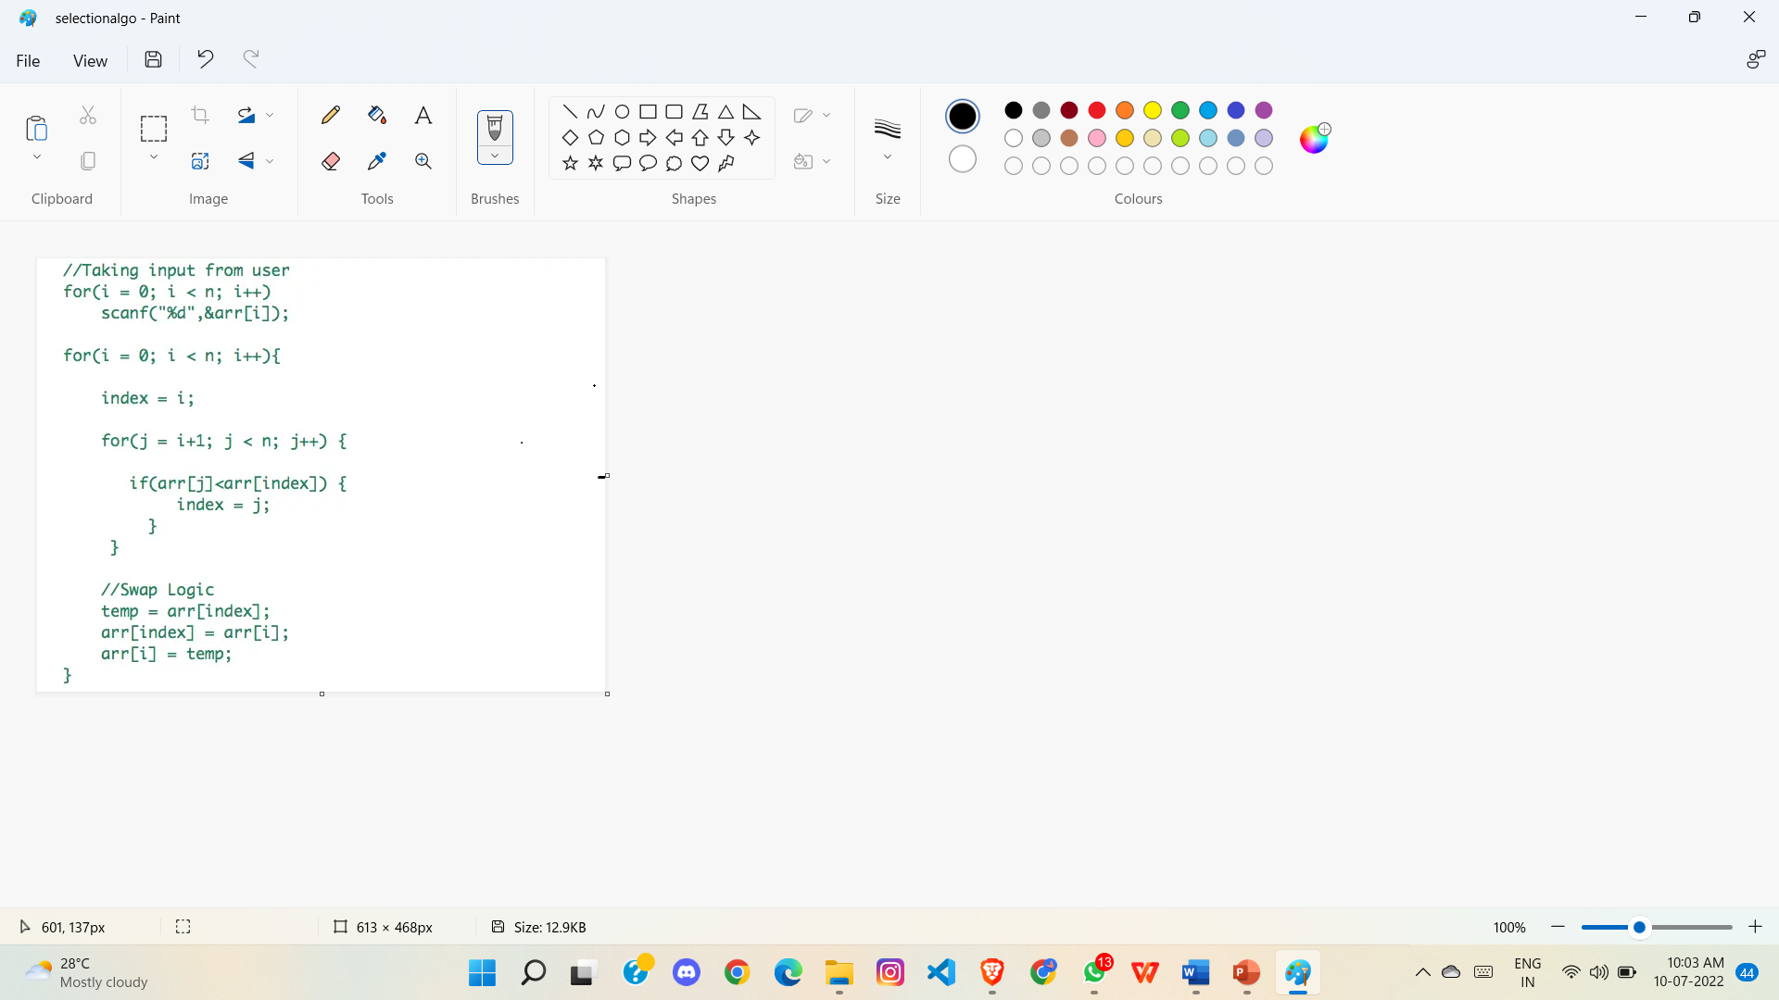
algorithm

Slide 14
Time Complexities:
Worst Case Complexity: O(n2) If we want to sort in ascending order and the array is in descending order then, the worst case occurs.
Best Case Complexity: O(n2) It occurs when the array is already sorted
Average Case Complexity: O(n2) It occurs when the elements of the array are in jumbled order (neither ascending nor descending).
The time complexity of the selection sort is the same in all cases. At every step, you have to find the minimum element and put it in the right place. The minimum element is not known until the end of the array is not reached.
Space Complexity:
Space complexity is O(1) because an extra variable temp is used.

Slide 15
Insertion sort
In this method the elements are inserted at their appropriate place. Hence is the name insertion sort.
Like sorting a hand of playing cards start with an empty hand and the cards facing down the table.
Pick one card at a time from the table, and insert it into the correct position in the left hand.
Compare it with each of the cards already in the hand, from right to left
The cards held in the left hand are sorted.

Slide 16
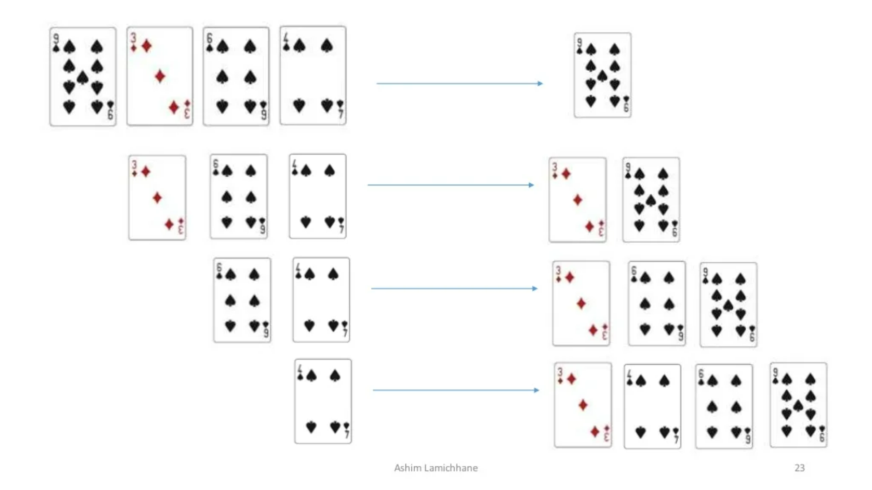

Slide 17
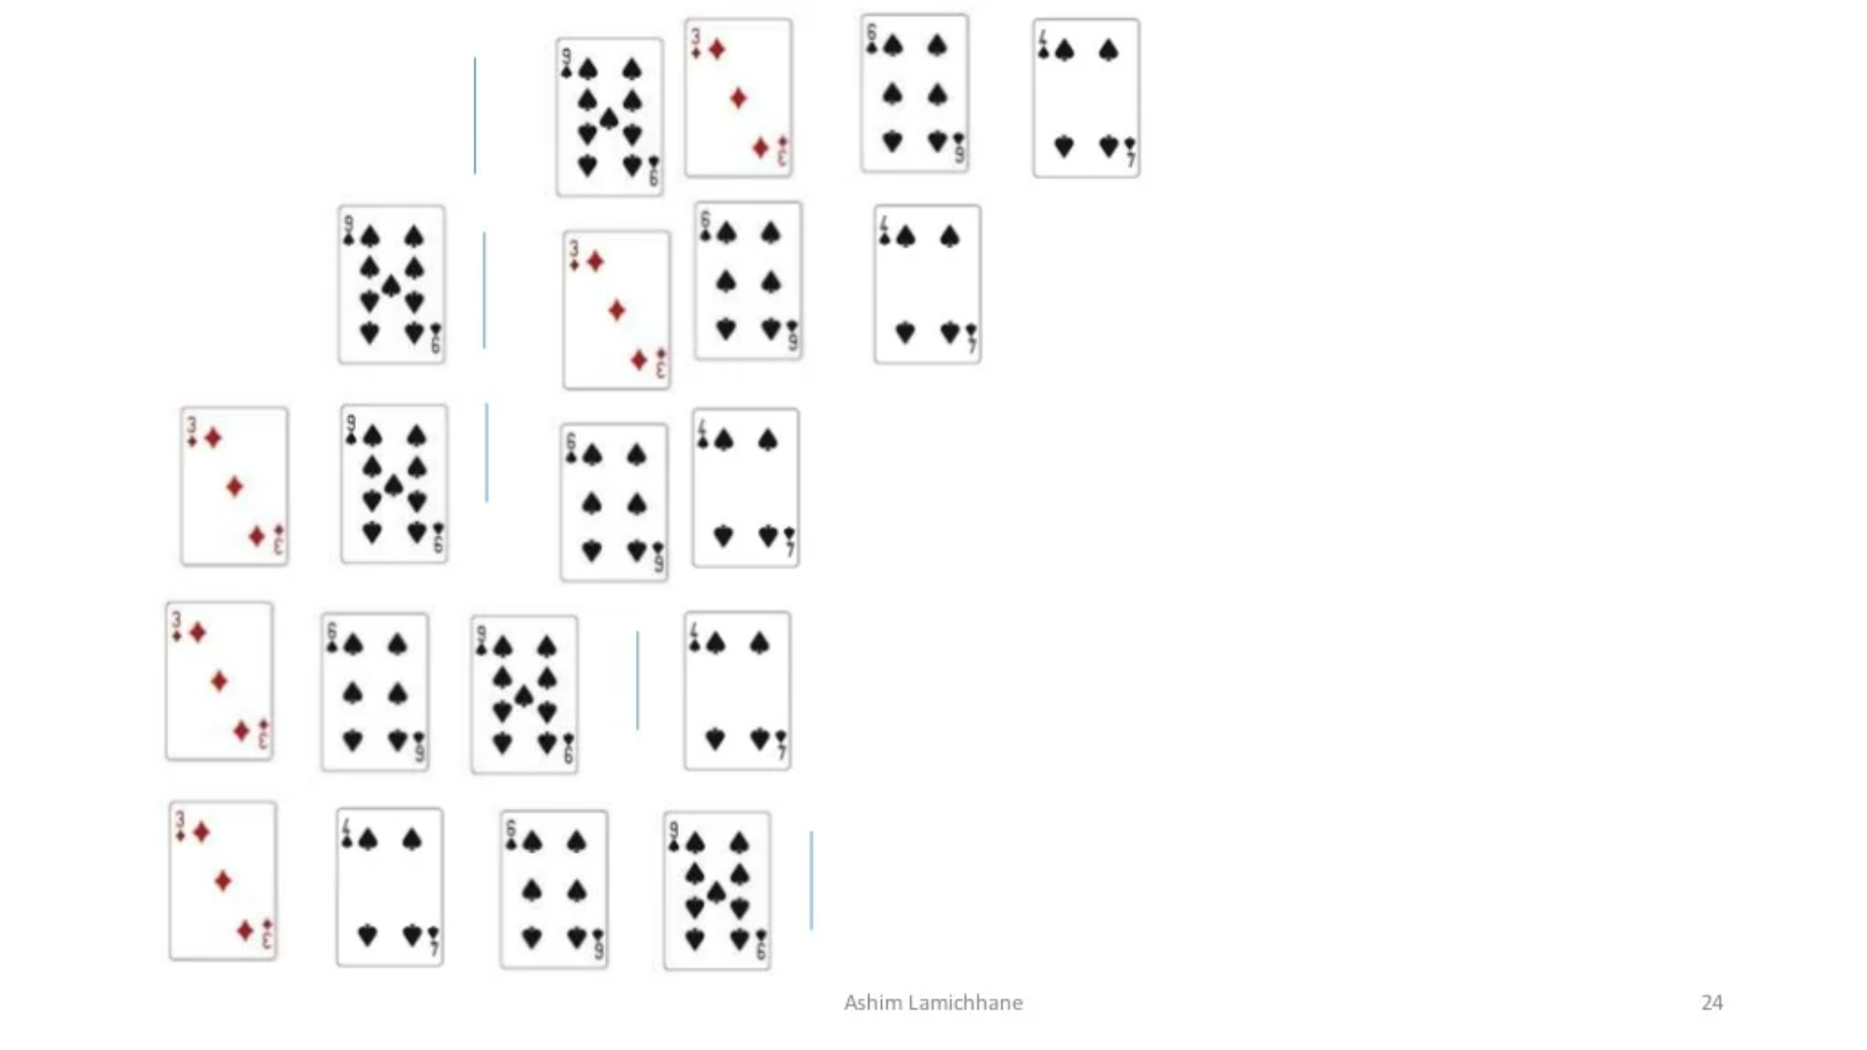

Slide 18
Insertion sort
Suppose an array a[n] with n elements. The insertion sort works as follows:
Pass 1: a[0] by itself is trivially sorted.
Pass 2: a[1] is inserted either before or after a[0] so that a[0], a[1] is sorted.
Pass 3: a[2] is inserted into its proper place in a[0], a[1] that is before a[0], between a[0] and a[1], or after a[1] so that a[0], a[1], a[2] is sorted.
Pass N: a[n-1] is inserted into its proper place in a[0], a[1], a[2],.......,a[n-2] so that a[0], a[1], a[2],..........,a[n-1] is sorted with n elements.

Slide 19
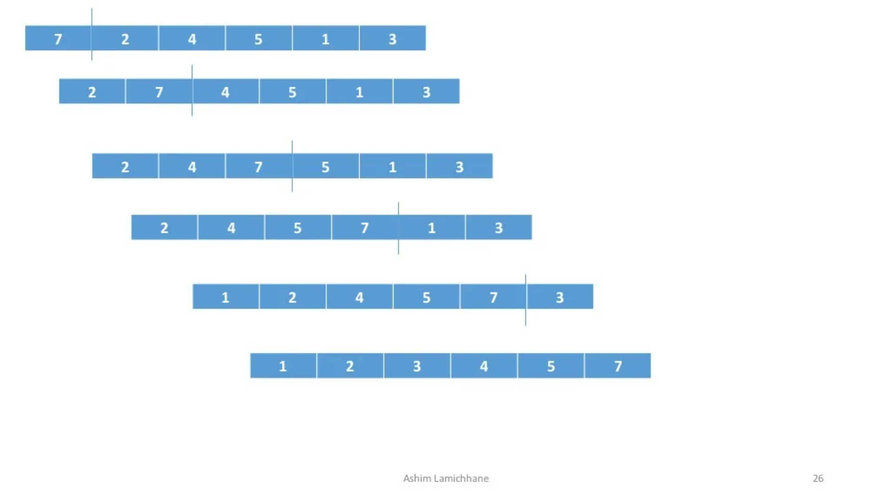

Slide 20
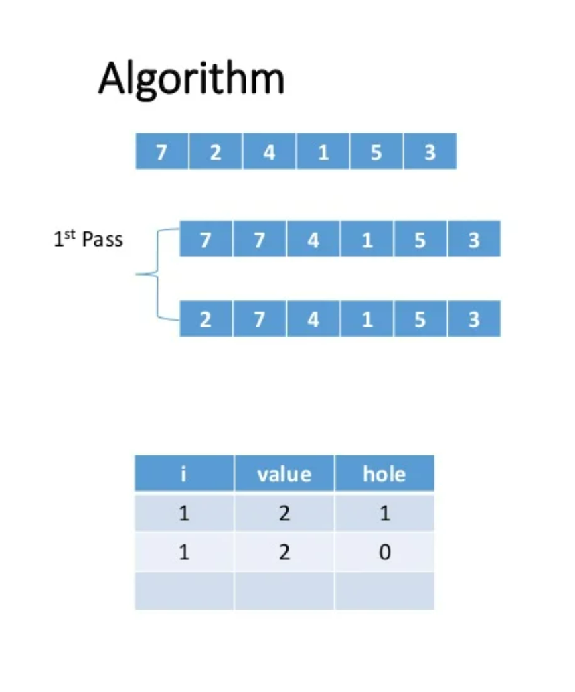
void insertion(int a[],int n)
{
int i,j,temp;
for(i=1;i<n;i++)
{
temp=a[i];
for(j=i; j>0 && temp<a[j-1];j--)
{
a[j]=a[j-1];
}
a[j]=temp;
}
}

Slide 21
Time complexities:
Worst Case Complexity: O(n2) Suppose, an array is in ascending order, and you want to sort it in descending order. In this case, worst case complexity occurs. Each element has to be compared with each of the other elements so for every nth element (n-1) number of comparisons are made. Thus, the total number of comparisons = n*(n-1) ~ n2
Best Case Complexity: O(n) When the array is already sorted, the outer loop runs for n number of times whereas the inner loop does not run at all. So, there are only n number of comparisons. Thus, complexity is linear.
Average Case Complexity: O(n2) It occurs when the elements of an array are in jumbled order (neither ascending nor descending).
Space Complexity
Space complexity is O(1) because an extra variable temp is used.

Slide 22
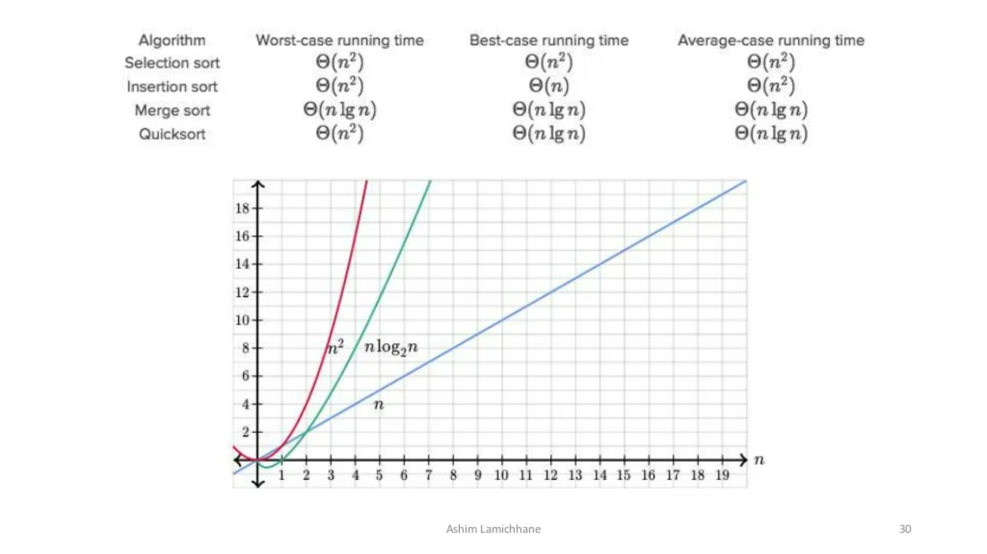
Comparison b/w different sorting algorithms:

Slide 23
Points to remember :
Sorting can be performed in many ways.
Over a time several methods (or algorithms) are being developed to sort data(s).
•Bubble sort, Selection sort, Insertion sort are the few sorting techniques discussed in this session
Which is best algorithm according to you ?
It is very difficult to select a sorting algorithm over another. And there is no sorting algorithm better than all others in all circumstances.

Slide 24
Points to remember:
The complexity of a sorting algorithm measures the running time of a function in which n number of items are to be sorted.
The choice of sorting method depends on efficiency considerations for different problems.
Three most important of these considerations are:
The length of time spent by programmer in coding a particular sorting program
Amount of machine time necessary for running the program
The amount of memory necessary for running the program

